Slide 1
Senior Software Engineering Project (Mobile Application Team)
Spring 2013
Team Members: Corey Young, Mason Reams, Thomas Heckwolf
Team Lead: Erin Corona
Instructor: Dr. Adam Lewis

Slide 2


Overview
Mission
Design Mobile Application
Begin Storyboard Process
Begin Development Process.

Slide 3



Tools
Eclipse
Juno
Plugin’s
Subclipse
http://subclipse.tigris.org/update_1.8.x
ADT
http://developer.android.com/tools/adk/index.html
Mylyn Trac Connector

Slide 4


Tools Cont.
SDK
SDK Tools, Revision 21.1.0 (February 2013)
Tortoisesvn
http://tortoisesvn.net/

Slide 5

Documentation
Documents
Temporary
Google Drive Folder
Final
/fiddlers/MobileAppDocuments/
User Stories
Trac
Android Application Project:
/fiddlers/MobileApp/

Slide 6
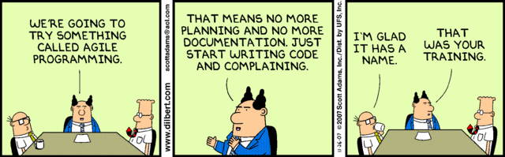
Agile

Slide 7
User Stories
Format:
As a <User,Devevloper,Tester> , goal
Acceptance Criteria:
To know when Done.
Story Points:
Value to allow for estimates and Burn Down.
Location:
http://mcs.athens.edu/trac
Owner: Mobile App Group

Slide 8
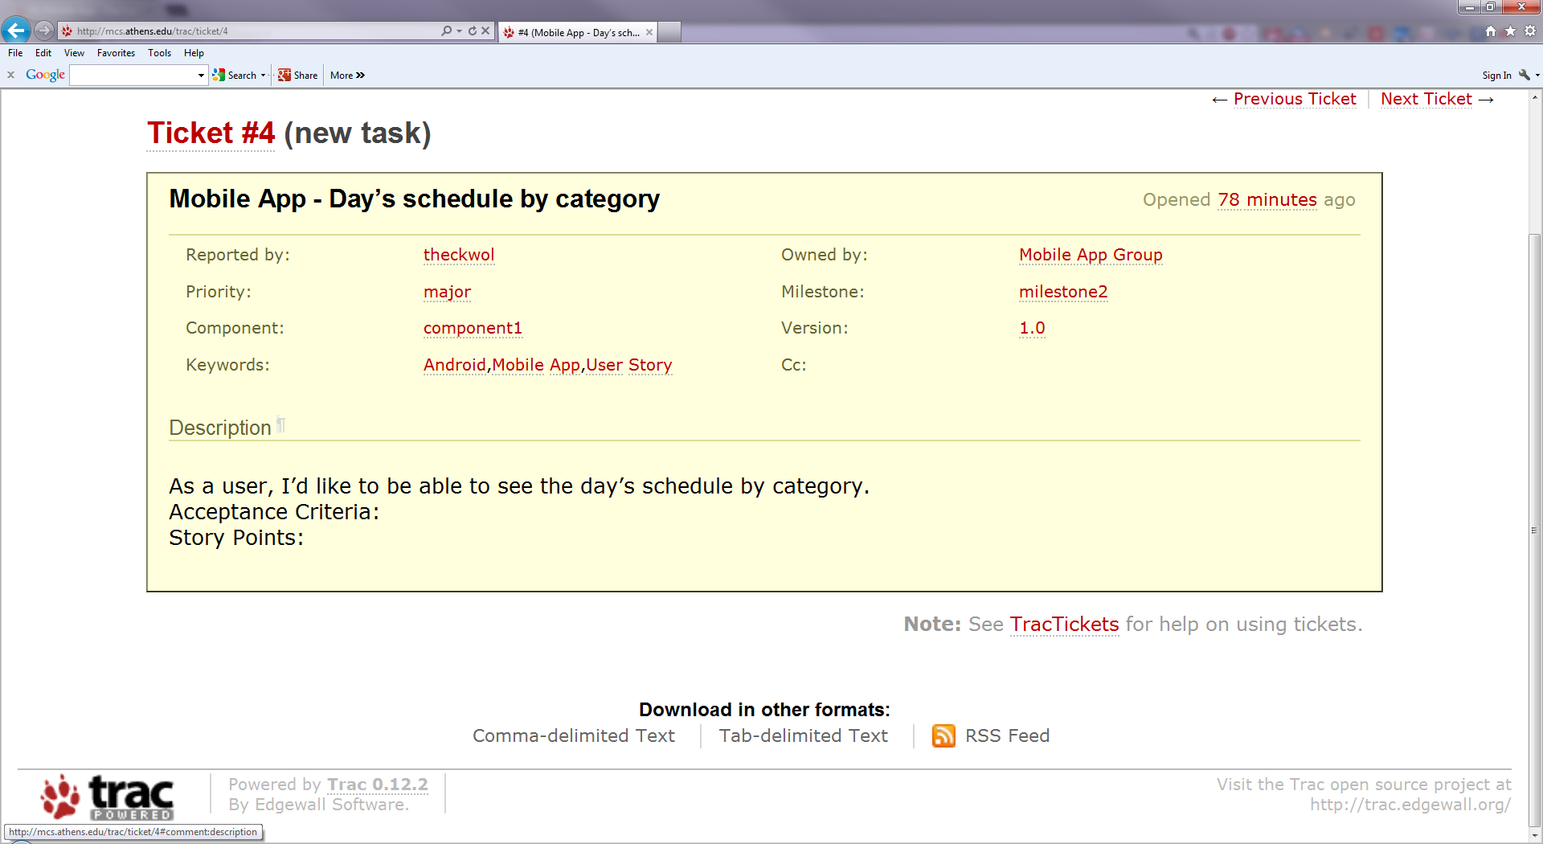

Slide 9
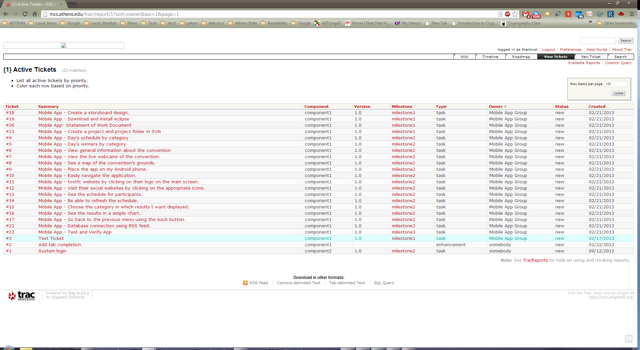

Slide 10
Mobile App Design
Efficient
Feasible
Simple

Slide 11
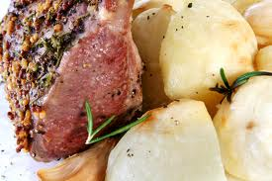
Mobile App Design (Meat and Potatoes)

Slide 12

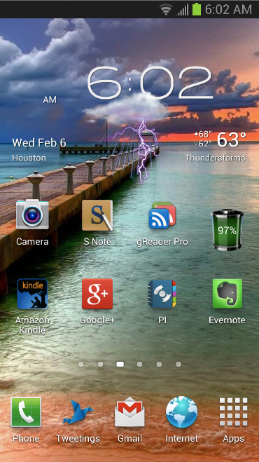

Phone
Home
Screen
Fiddlers

Slide 13

Phone Apps
Page
TVOTFC

Slide 14


App
Home Page
-Winners
9:10AM
What would you like to do?
Schedule
Contestants
Winners
Map
Fiddler Cam
Notes:
Home Screen

Slide 15

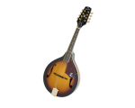

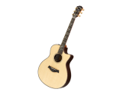
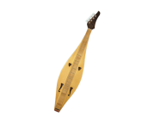
First Choose
Category of
Winners
To view
9:10AM
Choose a Category
Harmonica
Mandolin
Dobro
Guitar
Dulicmer

Slide 16
Winners
-Per Category
Displayed
9:10AM
Harmonica
WINNERS
Name Address
1st Ken Tenpenny Murfreesboro, TN
2nd Isaac Vick Lyles, TN
3rd Wailin Wood McEwen, TN
4th Rob Pearcy Smyrna, TN
5th Tommy Bounds Sylacauga, AL

Slide 17
Next Up
Contestants
-Per Category
9:10AM
Dobro
8:00 - Ken Tenpenny | 8:45 - Tyler Andel
8:05 - Joshua Ford | 8:50 - Damion Kidd
8:10 - Tommy Bounds | 8:55 - Tommy & Taylor Bounds
8:15 - Benjamin Lin | 9:00 - Rob Pearcy
8:20 - Daniel Amick | 9:05 - Joel Whittinghill
8:25 - Caleb Bryant | 9:10 - Carl Franklin
8:30 - Chris Gray | 9:15 - Ward Family Bluegrass
8:35 - Joel Whittinghill | 9:20 - Slim Chance Band
8:40 - Caleb Bryant | 9:25 - Moonshine

Slide 18

9:10AM
Fiddler Cam
FIDDLER CAMS
Take a look at one of our LIVE Fiddler Cams located around the Athens State University Campus. Click one of the links below to take you to Live Cam feed.
Founders Hall Cam Brown Hall Cam Alumni Fountain Cam

Slide 19
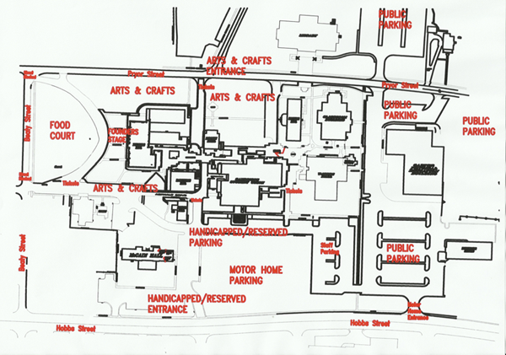
Map

Slide 20
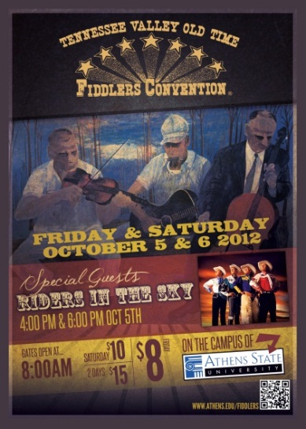
Info-1
9:10AM
Family,
Friends,
Fiddlers!
 | YOU'RE INVITED! To the 47th Annual Tennessee Valley Old Time Fiddlers Convention. Bring the family and enjoy a uniquely American experience whose roots are buried deep in the Appalachian mountains and beyond. It's a musical and cultural experience that will thrust you into a simpler time where families were bound by the music they created and the stories they told.

Slide 21
Info-2
9:10AM
GENERAL INFORMATION
Admission
Friday: Gates open at 8 a.m. Saturday: Gates open at 7:30 a.m.
Admission Costs
$8.00 Friday, October 4, 2013 $10.00 Saturday, October 5, 2013 $15.00 for Both Days Children under 12 Free with Parents **No Pets Allowed Inside the Convention Gates **No Coolers Allowed Inside the Convention Gate.

Slide 22
Info-3
9:10AM
GENERAL INFORMATION
Considerations
Stage is outdoors - Bring lawn chairs
Contests will be held in Gym in event of rain. Limited Capacity - NO REFUNDS
Admission ticket will pay the entry fee for one category of competition.
Free Camping - No Hookups

Slide 23



The Project Status
Done
Next
Future

Slide 24
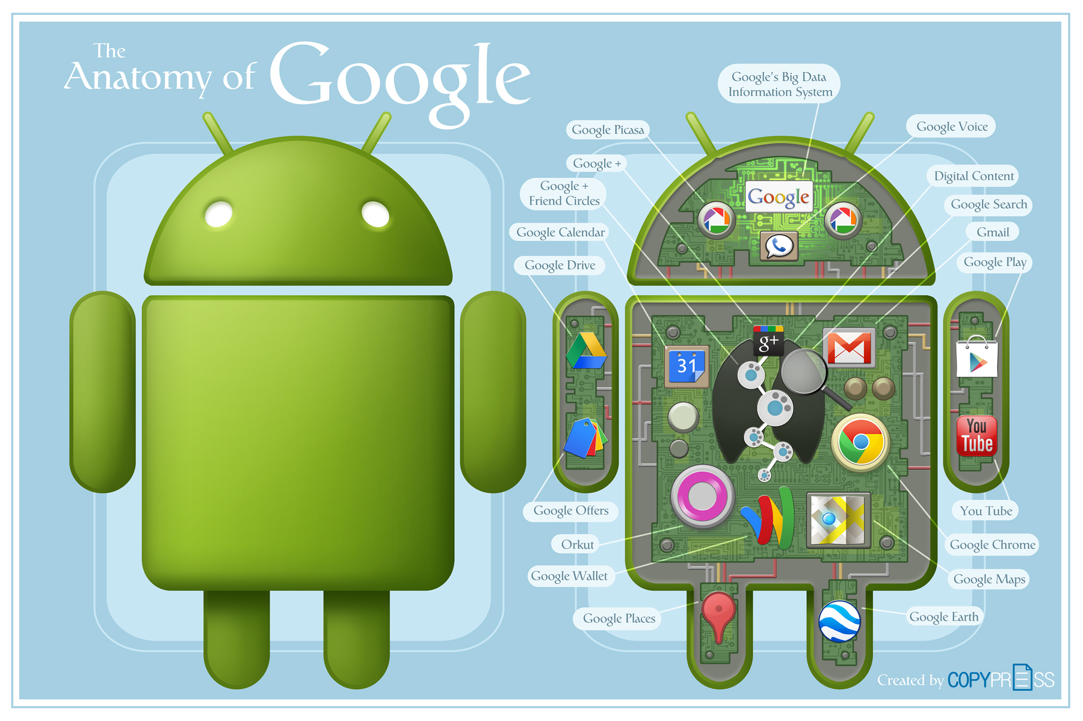
The Project

Slide 25

Current State of Project

Slide 26
Current Confidence
BAD | Neutral | GOOD

Slide 27


Slide 28
Disclaimer
Google , Google Logo , Android , and Android Logo are registered trademarks of Google Inc. © 2012 Google Inc. All rights reserved.
Eclipse Logo , Copyright © 2013 The Eclipse Foundation. All Rights Reserved.
Trac Logo, Copyright © 2003-2012 Edgewall Software. All rights reserved.
Tigris.org Logo , © 2001 - 2009 CollabNet. CollabNet is a registered trademark of CollabNet, Inc.
Subversion Logo , Copyright © 2012 The Apache Software Foundation
Fiddlers Logo and Images , Copyright © 2013 Tennessee Valley Old Time Fiddlers Convention. All Rights Reserved.
Tortoisesvn , 2004-2012 - THE TORTOISESVN TEAM
Dilbert Carton , Dilbert ©2013, Universal Uclick
Athens State University Logo , Copyright © 2012 Athens State University

